Slide 1





ENGLISH FOR STUDENTS
IN INFORMATION SCIENCE

Slide 2




Real world situation
UMK English
Information Science
Subject

Slide 3

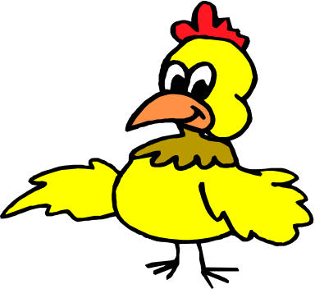
Four language skills (input) Reading
Listening
(output/product) Writing
Speaking
Three language components Pronunciation
Vocabulary
Grammar

Slide 4
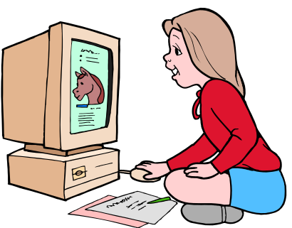


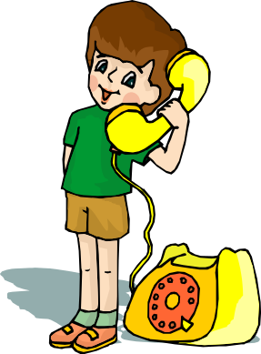
What we study English for?
To learn knowledge
To communicate written
spoken

Slide 5


ENLARGING KNOWLEDGE
Reading
LEARNING Knowledge
Understanding

Slide 6
TEXT UNDERSTANDING
Pronunciation
Vocabulary TEXTS Meaning
Grammar

Slide 7

READING TEXTS
COMPUTER
Vocabulary Texts
INFORMATICS

Slide 8
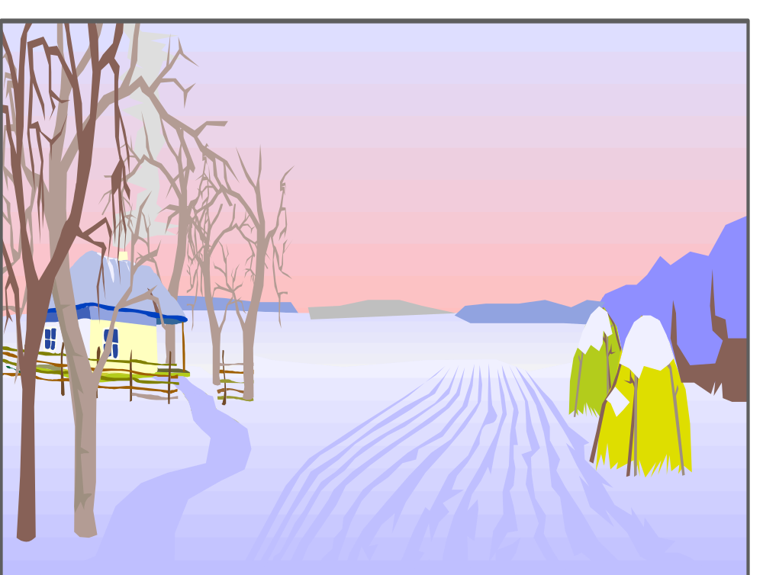
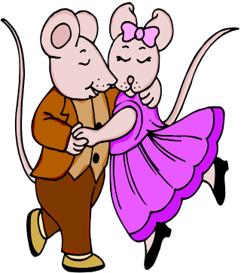
Thank you

